Slide 1


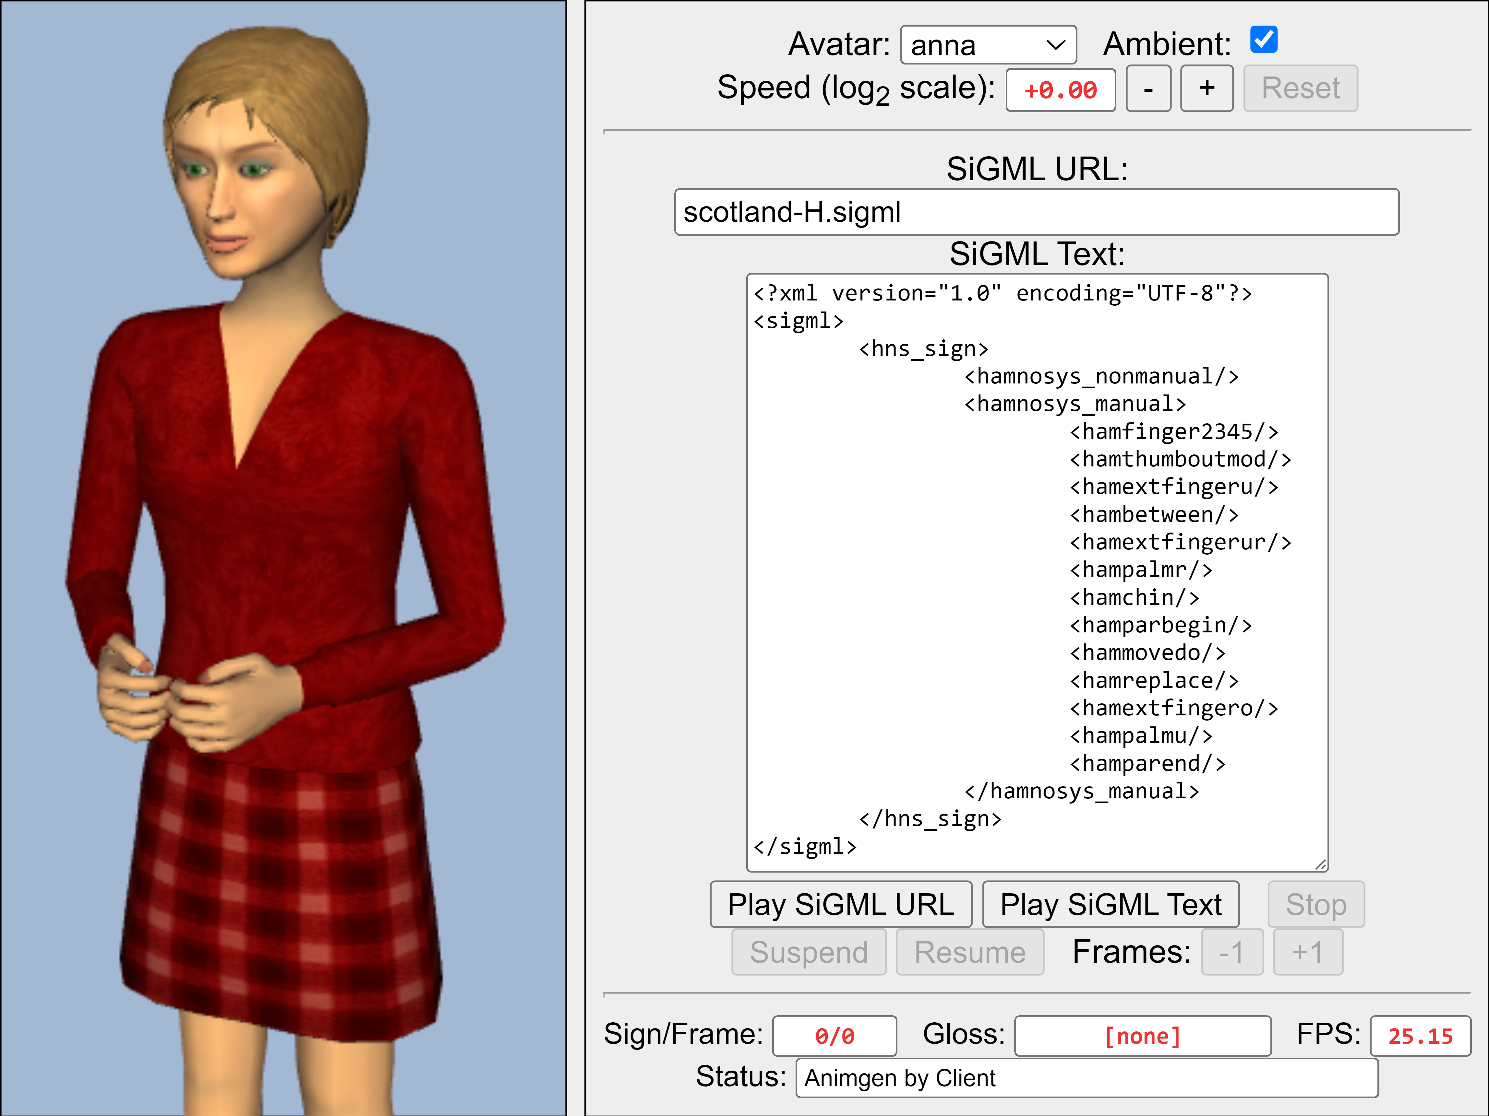
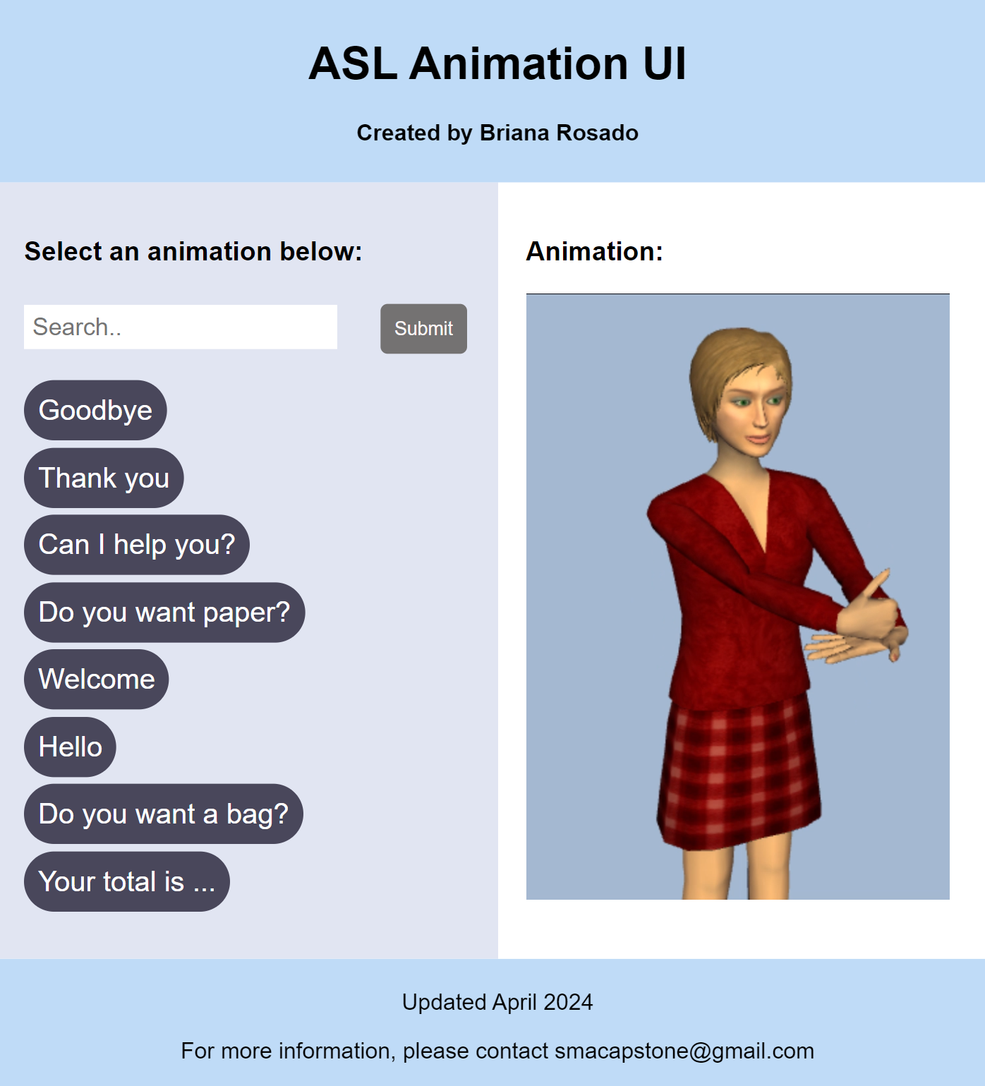
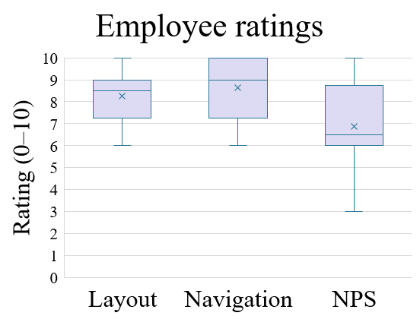
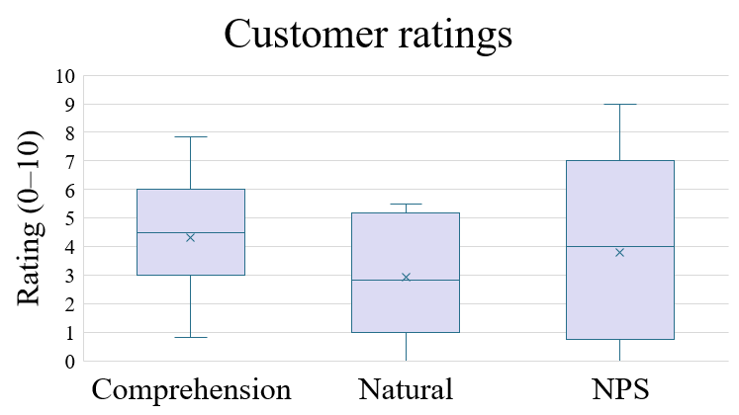
Designing a prompt-based ASL translation interface for retail settings
Briana Rosado
Mentored by Mr. Jarick Cammarato
Introduction
Materials and Methods (continued)
Results (continued)
Despite the prominence of American Sign Language (ASL) in America, many services are inaccessible to those who are deaf or hard of hearing. In retail settings especially, translation services are not readily available to or are inconvenient for the customer or the employee.
Current methods that companies use to communicate with deaf customers include writing utensils, a live translator, closed captioning devices, or having the customer rely on lip-reading. However, these methods come with drawbacks: using writing utensils can interrupt the flow of the conversation and drags out the interaction; a live translator can be expensive and may not always be available; closed captioning equipment can also be expensive as well as inaccurate at times; and not all customers who are deaf or hard-of-hearing are fluent in lip-reading.
Researchers in Germany found a similar problem where many train station announcements were conveyed verbally, leaving deaf commuters unaware of delays or station changes. To solve this, researchers attempted to make a visual aid that displayed German train announcements in sign language. They generated animations of an avatar signing the information using JASigning, a sign language animation software produced by the Virtual Humans Group at the University of East Anglia (2021). They tested their animations on a focus group comprised of seven deaf signers who provided suggestions, such as changes to the hand shape and the direction of the avatar’s gaze (Ebling & Glauert, 2016). A similar method could be applied to a retail setting to improve the experience for those who communicate in ASL. The goal of this project was to design an inexpensive translation interface that could be used in retail settings to improve the customer and employee experience.
Once the HamNoSys Unicode was obtained,
it was entered into HamNoSys2SiGML.py, a
python application created by Carolina Neves
(2021) that generates the corresponding SiGML.
The SiGML (Figure 2) was copied into the
JASigning software (Figure 3) to generate
videos for each of the phrases. The final user
interface (UI) was coded in Visual Studio Code
using HTML and CSS to format the page as
well as JavaScript for back-end development
(Figure 4). The UI was designed to have an
adaptable layout which worked on different screen sizes and devices.
A group of hearing volunteers with retail experience were each given a five-minute training session on how to use the UI and were then asked to re-enact a scenario in which they were using the UI to aid a customer who relied on ASL. Following this, the “employees” were asked to fill out a survey on their experience using the UI (Graph 2). The survey requested users to rate the UI layout, how easily they could navigate the system, and how likely they were to recommend the system (NPS).
<sigml><hns_sign>
<hamnosys_manual>
<hamfinger2345/>
<hamthumboutmod/>
<hamextfingeru/>
<hambetween/>
<hamextfingerur/>
<hampalmr/>
<hamchin/>
<hamparbegin/>
<hammovedo/>
<hamreplace/>
<hamparend/>
</hamnosys_manual>
</hns_sign></sigml>
Figure 2 (left): The SiGML translation of “Thank you.”
Figure 3 (right): The JASigning software generating the animation.
Conclusion
According to Bunker (2024), an NPS score of 8 or higher represents if a user is truly satisfied with the product whereas a 7 or lower indicates there is still some customer dissatisfaction. Based on the average NPS from each group of volunteers (Graphs 1 and 2), the interface is not likely to be promoted or provide a unique customer experience. Much of the feedback regarding the animations proposed difficulties understanding the clunkiness of the avatar’s movements. Additionally, the avatar design was not perceived as visually appealing and thus often left users feeling unsettled or distracted. JASigning also does not provide much support for facial expressions/non-manual gestures like raised eyebrows and head tilts. As a result, many of the signs were not fully accurate as compared to a human translator. Another limiting factor of the methods of this project was that HamNoSys can become lengthy when transcribing sentences, thus making it inconvenient for longer phrases.
If these issues were resolved, the UI could be expanded to include more than the eight phrases currently translated. Furthermore, instead of using JASigning, an alternate animation software should be implemented so the avatar looks more natural and allows for more customizability regarding facial expressions and movements.
Figure 4 (above): The ASL animation interface includes eight phrases.
Results
To ensure accuracy of the translations, a survey was sent to several ASL communities for participants to remotely view videos of the animations and fill out a form to provide feedback (Graph 1). On the survey, the volunteers were asked to rate the comprehensibility of the sign, how natural the movement was, and were provided a textbox for any additional comments/feedback. The usefulness of the system was evaluated based on the Net Promotor Score (NPS) which is a measure of how likely a user is to recommend the product to a family member or friend.
Materials and Methods
To help with the translation process of spoken language to sign, Hamburg Notation System (HamNoSys) and Signing Gestural Markup Language (SiGML) were utilized. HamNoSys is a symbol-based method to write down signs (Figure 1). SiGML is the Extensible Markup Language (XML) format of HamNoSys. A set of English phrases commonly used in retail settings were selected to be translated into ASL. Videos of the translations were sourced through online databases and transcribed into HamNoSys using the HamNoSys Palette, a software application designed by Thomas Hanke (2021) that allows users to enter HamNoSys onto a computer.
References
Bunker, A. (2024). What is NPS? The ultimate guide to boosting your Net Promoter Score. Qualtrics.
https:/www.qualtrics.com/experience-management/customer/net-promoter-score/
Ebling, S., & Glauert, J. (2016). Building a Swiss German sign language avatar with JASigning and evaluating it among the deaf community. Universal Access in the Information Society, 15(4), 577–587. https://doi.org/10.1007/s10209-015-0408-1
Hanke, T. (2021). HamNoSys (Version 4.1.7) [Computer software]. Universität Hamburg. http://doi.org/10.25592/uhhfdm.9725
Neves, C. (2021). HamNoSys2SiGML (Mar 28 version) [Computer software]. GitHub. https://github.com/carolNeves/HamNoSys2SiGML
Virtual Humans Group. (2021, January 18). JASigning.
https://vh.cmp.uea.ac.uk/index.php/JASigning
Figure 1: The HamNoSys transcription for “Thank you.”

Graph 1: The survey was completed by 11 volunteers who knew ASL. The average NPS of the “customer” volunteers was 3.7.
Graph 2: A total of eight volunteers were surveyed. The average NPS was 6.9.
Notes:
Embedded font
Hamnosys2sigml citation as per computer software citation (https://libraryguides.vu.edu.au/apa-referencing/7DatasetsSoftwareTests)

